Slide 1
OWASP
Much More Than Just OWASP Top 10
Sven Strittmatter

Slide 2

Sven Strittmatter
Lead Security Expert at iteratec
Chapter Stuttgart Lead at OWASP
🤓 Computer nerd since 8.
🤑 Computer stuff for money since 20+ years.
😭 Got hacked in one of my first jobs.
🧐 Since preaching security w/o being asked.
🤔 Now I’m a security consultant.

Slide 3

My Company
iteratec GmbH
No, we’re not the company which makes sound cards 😩
That’s Terratec 😉
We do individual software development sinc 25+ years.
Java, JavaScript, TypeScript, Go, Python etc.
Hire us when failure is not an option!
Since 10+ years we do security.
Because that’s part of it!
Consulting, Training, Pentesting.
500+ Emplyees, 7 Offices.
TISAX & ISO27k certified.
It really is my company 😀
49 % is owned by iteratec nurdemteam eG.
Remaining 51 % coming soon.
We use a lot of OWASP stuff 😬
BTW: My boss urged me to become OWASP member some years ago 😂

Slide 4

No AI Showing Up 😬
I don’t bother you w/ AI generated images,
but with smileys and GIFs 😂

Slide 5
What Is OWASP?
Obviously more than the Top 10 😂

Slide 6
What Is OWASP?
Our Mission
The Open WebWorldwide Application Security Project is a nonprofit foundation that works to improve the security of software. Our offer includes:
Community-led open source projects.
Over 250+ local chapters worldwide.
Tens of thousands of members.
Industry-leading educational and training conferences.

Slide 7
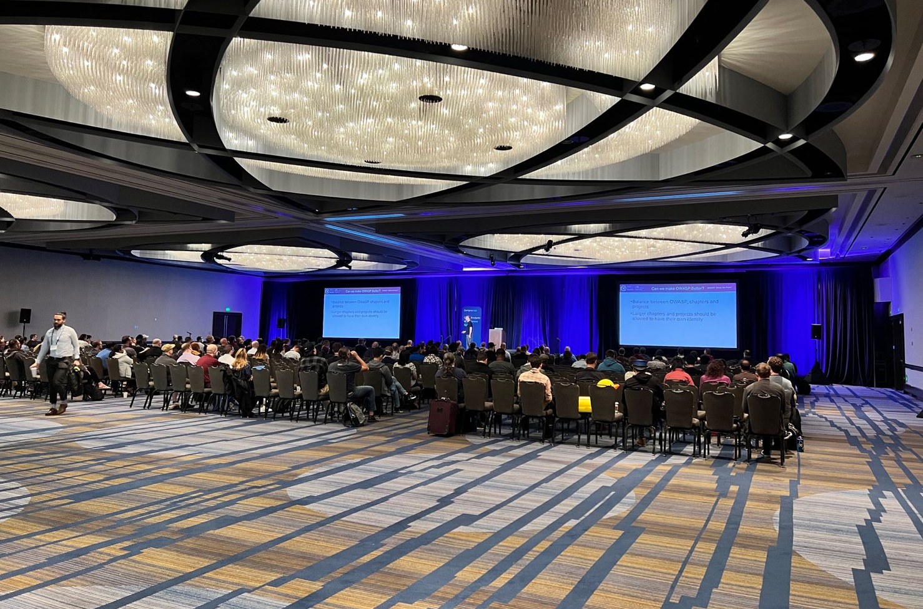
What Is OWASP?
Our Community
OWASP is a worldwide free and open community focused on improving the security of application software.
Our goal is to make application security visible, so that people and organizations can make informed decisions about application security risks.
Picture from Global AppSec 2022 by Noah Yisa via LinkedIn.

Slide 8
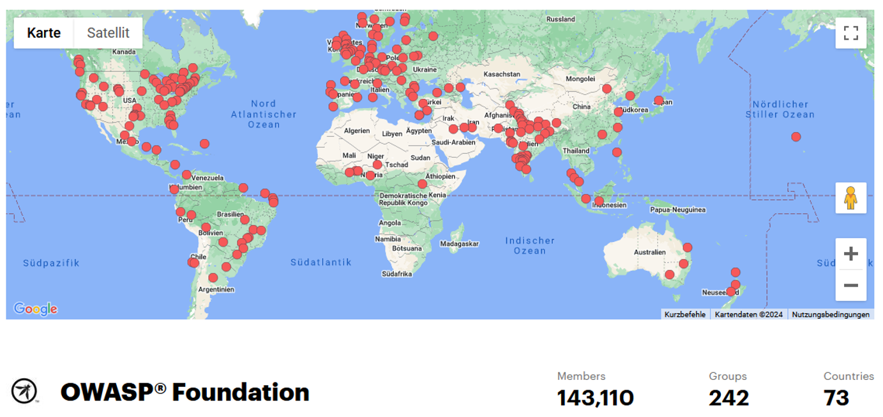
What Is OWASP?
World Wide Organized In Local Chapters
German Chapter:
Lead: Tobias Glemser
German OWASP Day
2025 maybe Düsseldorf 🤔
Stuttgart Chapter:
Lead: Johannes Merkert & me
Stammtisch w/ 🍺 & 🌭
Organized via Meetup.
Lots of other chapters w/ Stammtische/Meetups
https://owasp.org/chapters/
Get in touch
Mailing list,
Slack, or
Just talk to me 🤗

Slide 9

What Is OWASP?
It’s All Free
Everyone is free to participate. 🤗
No membership required!
All materials are available under free & open licenses.
All OWASP events are free to attend for anyone.
Except conferences, we charge net cost prices. 😀
No need for any entry qualification.
All creatures are welcome. 🤗
Yes, I know, it's from the CCC. 😬
Picture from: https://owasp.glueup.com/

Slide 10
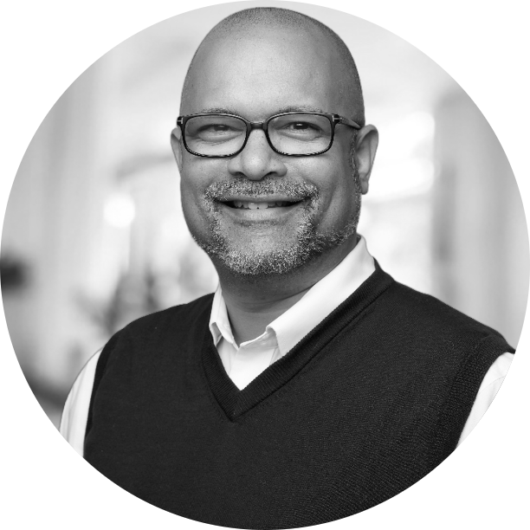


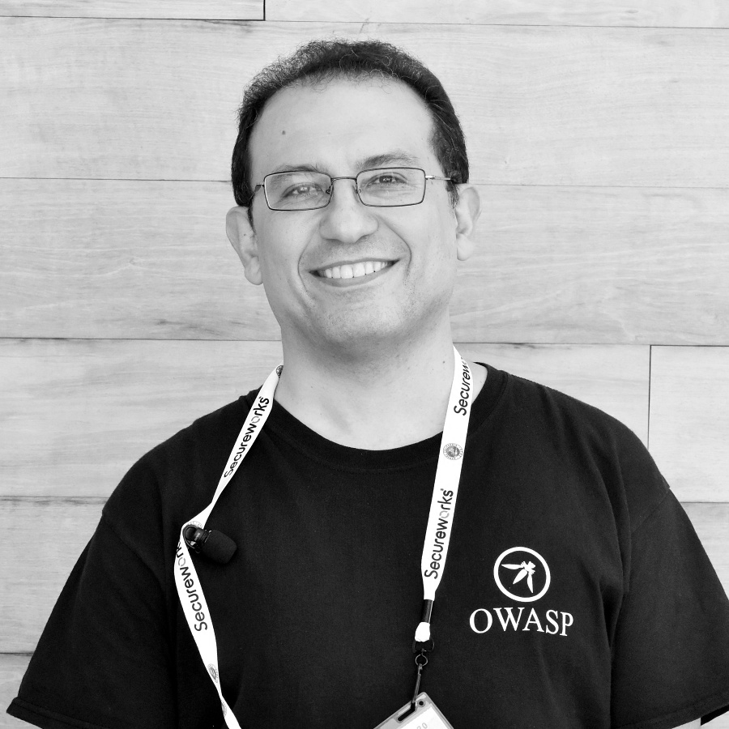
What Is OWASP?
The OWASP Foundation
We are a global not-for-profit charitable organization.
Vendor-neutral community.
Collective wisdom of the best minds in application security worldwide.
Provide free tools, guidance, and documentation.
Relying on donations.
Corporations can become members, too.
Board of directors elected by community.
Board meetings open to the public.
https://owasp.org/www-board/
Sadly, no women elected to board. 🙈
Current Board 2025:
Ricardo Griffith
Steve Springett
Harold Blankenship
Sam Stepanyan

Slide 11
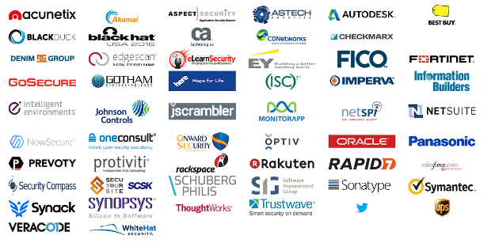
Contributing Members
These Corpotate Members Support OWASP at $5.000 Level Annualy (Silver)

Slide 12












Contributing Members
Diamond Members
Platinum Members
Become a member and support OWASP: https://owasp.org/supporters/

Slide 13
OWASP Projects
There is way more than OWASP Top 10

Slide 14

OWASP Projects
You got that wrong
“We use OWASP, we’re secure!”
“We do OWASP penetration testing!”
“We cover all risks of OWASP Top 10, we’re secure!”
A requirement for a real invitation to tender: “You must be OWASP Top 10 certifierd.” 😂
Pro-Tipp: If someone wants to sell you an OWASP certificate, then go ahead and find someone who knows!
BTW: 10 years ago “cyber” was an indicator for people who have no clue. 🤓

Slide 15
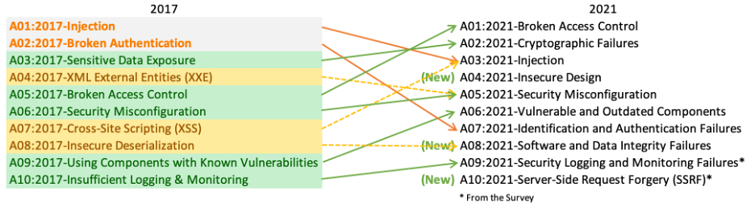
OWASP Projects
Top 10 Web Application Security Risks aka. OWASP Top 10
An opinionated list of most comon failures seen in (web) apps
Most of them you can also find in IoT, desktop apps, etc.
Largely applicable to non-web apps.
Data from static code analysis of 12 manufacturers/service providers.
The ranking is done by open survey of “experts”.
There is no science behind it!
https://owasp.org/www-project-top-ten/
Use it for
security awareness,
security training,
and push left security.
Don’t use it for anything else!
Pentesting → OWASP Web Security Testing Guide
Compliance → OWASP ASVS, OWASP SAMM, OWASP DSOMM

Slide 16

Some More Projects
Just a Short, Opinionated Excerpt

Slide 17
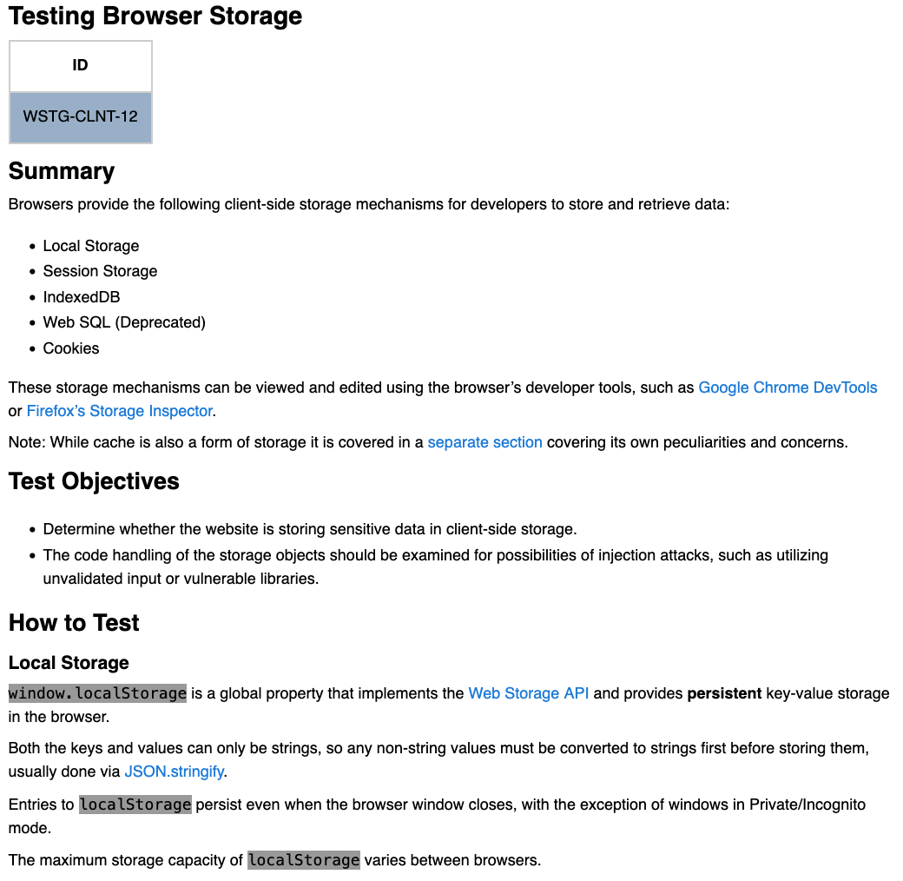
OWASP Projects
OWASP Web Security Testing Guide (WSTG)
Comprehensive guide to testing the security of web applications and web services.
Learn to hack yourself.
Use as test plan for penetration tests.
I’m not an OFFSEC guy. 😬
https://owasp.org/www-project-web-security-testing-guide/

Slide 18
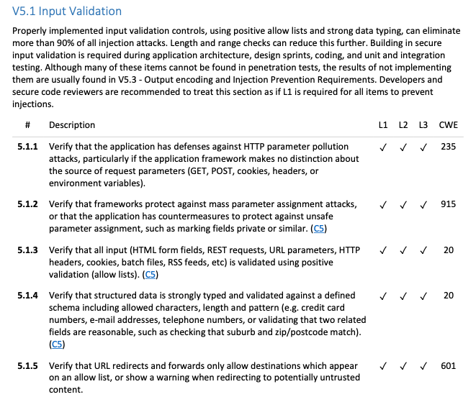
OWASP Projects
OWASP Application Security Verification Standard (ASVS)
Framework of security requirements.
Focus on security controls required when designing.
Comprehensive list of security requirements
divided by protection level and
grouped by topics (e.g. authentication, session management, input validation etc.).
Also useful for
governance or
checklist.
https://owasp.org/www-project-application-security-verification-standard/

Slide 19
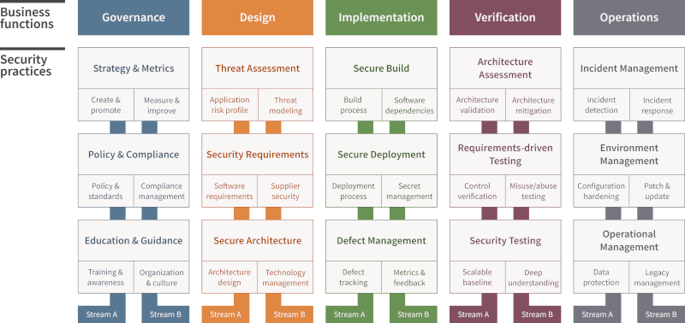
OWASP Projects
OWASP Software Assurance Maturity Model (SAMM)
Effective and measurable way for you to analyse and improve your secure development lifecycle.
Very mature.
Push security left.
But…
may need organization change
and nothing you can do in a few weeks.
https://owasp.org/www-project-samm/

Slide 20
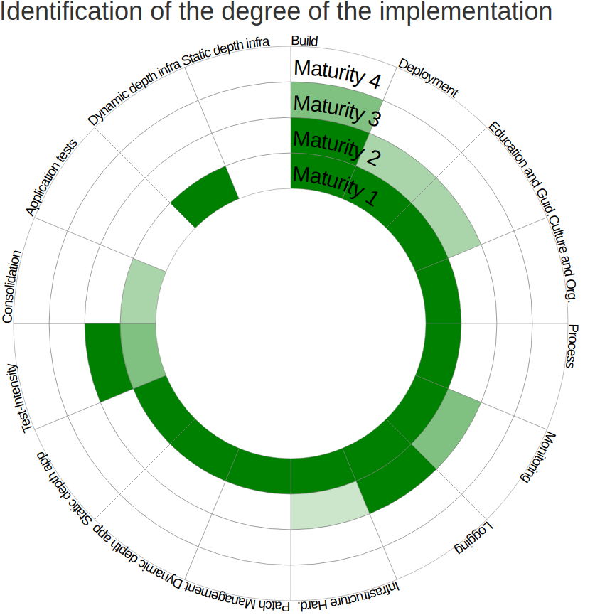
OWASP Projects
OWASP DevSecOps Maturity Model (DSOMM)
Maturity model for DevSecOps.
Very useful to see where you are.
More lightweight than OWASP SAMM.
Push security left.
Can be done in a team.
Mappings to
OWASP SAMM
ISO27001
https://owasp.org/www-project-devsecops-maturity-model/

Slide 21

OWASP Projects
OWASP Developer Guide
Introduction to security concepts.
Cross-reference to tools & documents from OWASP.
Must read for everyone doing IT.
Successor of the archived OWASP Secure Coding Practices-Quick Reference Guide.
I wish I had known about this ten years ago. 😂
https://owasp.org/www-project-developer-guide/

Slide 22

OWASP Projects
OWASP Cheat Sheet Series
No time to read the OWASP Developer Guide or role out OWASP SAMM?
Your bossy boss demands for features?
Just want to implement a secure…
… file upload
… password forgotten
… xyz
Just look for the right cheat sheet and follow it. 👍
https://owasp.org/www-project-cheat-sheets/

Slide 23
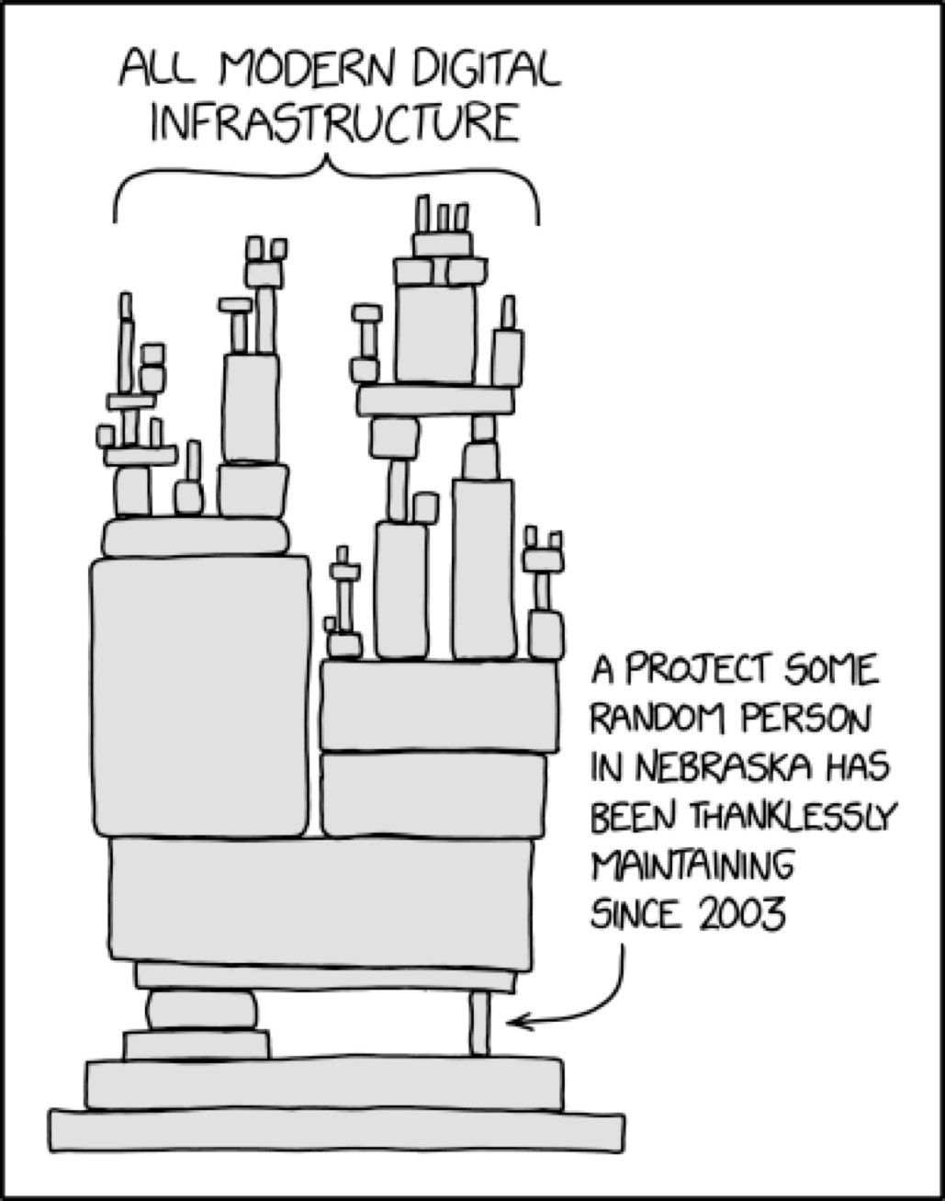
OWASP Projects
OWASP CycloneDX (ECMA-424)
Software bill of materials (SBOM) standard.
Why you need SBOMs?
You don’t want to syft through all your software, when next Log4J come around (right before x-mas).
You may have a chance to check what quadrillion dependencies the JS hackers added last week 😂
https://owasp.org/www-project-cyclonedx/
BTW: If you use free software in your company and you don’t pay for that, then you should read this Wikipedia article about gratis versus libre and tell your boss: https://en.wikipedia.org/wiki/Gratis_versus_libre
Log4J

Slide 24

OWASP Projects
OWASP Dependency-Check
Software Composition Analysis (SCA) tool.
Checks project dependencies for known vulns.
Easy to use & some integrations: CLI, Ant (yes, still exists), Maven, Gradle, Jenkins, Circle CI, SonarQube, …
Works for Java/JavaScript (done that) and others.
C/C++ → you’re screwed 😂
Output quite difficult to understand.
Personal advise: Just simply update everything regularly (at least weekly, use Renovate or such). 😉
https://owasp.org/www-project-dependency-check/

Slide 25
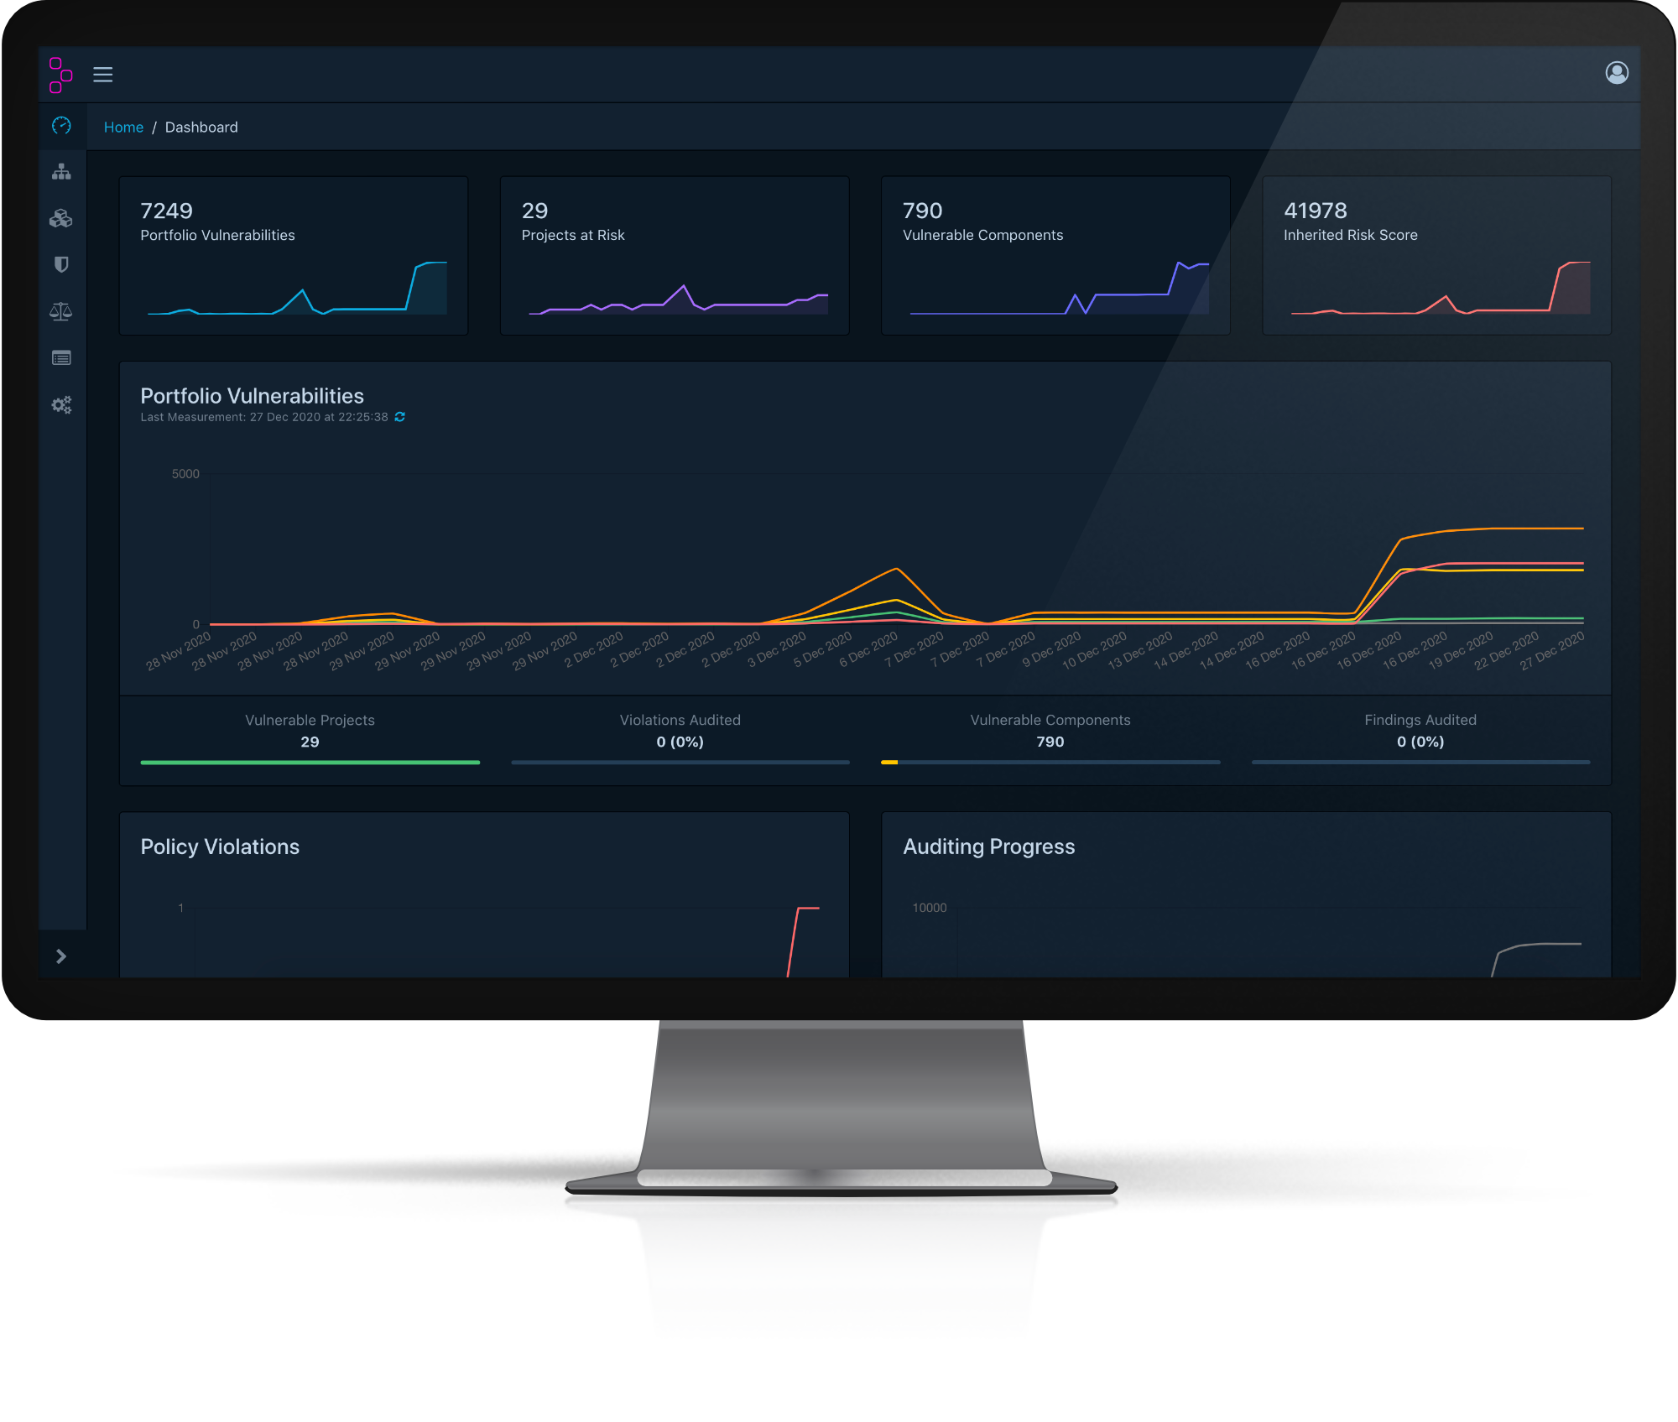
OWASP Projects
OWASP Dependency-Track
Consumes SBOMs.
Nice Web UI for all your dependencies (in your organization).
Log4J? → click, click, click and you know your usual suspects.
https://owasp.org/www-project-dependency-track/

Slide 26
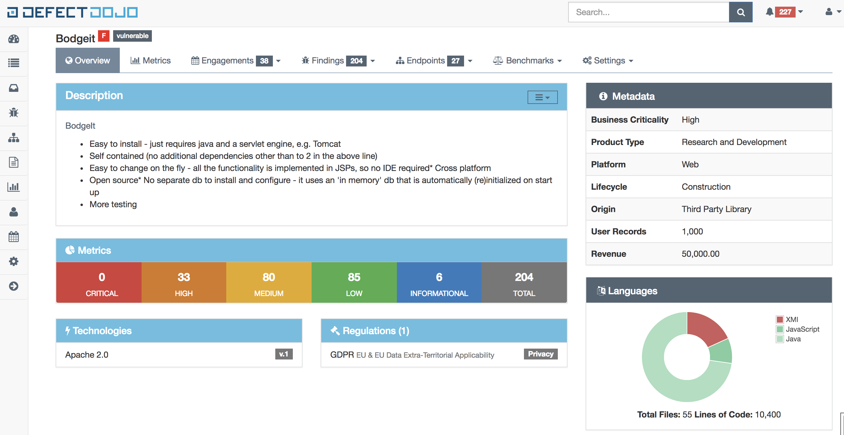
OWASP Projects
OWASP Defectdojo
Vuln management tool.
Use it to track-down the process of fixing vulns.
You can add vulns
manually, e.g. found by penetration test.
Automatically, e.g. found by tools like
OWASP Dependency-Track,
OWASP secureCodeBox,
whatever (has a rich REST API).
https://owasp.org/www-project-defectdojo/

Slide 27
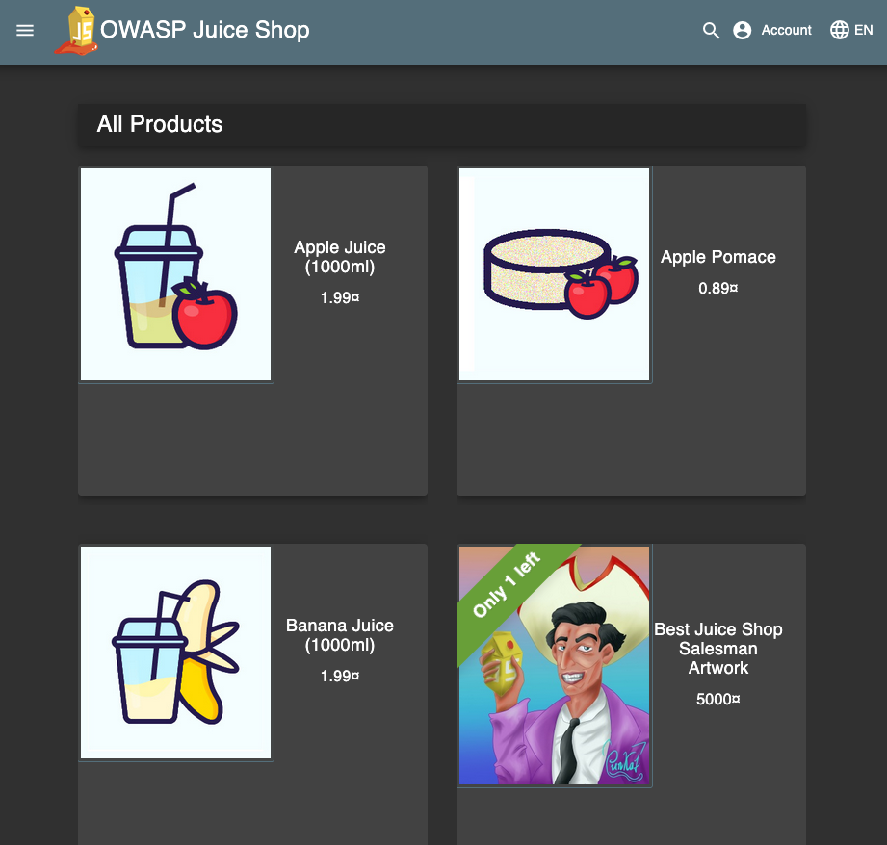
OWASP Projects
OWASP Juice Shop
Disclaimer: Jannik is my co-worker 😬
Insecure web shop.
Hence the name “Saftladen”, German slang for “lousy shop”.
Learn to hack & understand attack vectors.
IMO one of the greatest projects from OWASP!
Shout out to the maintainers Björn & Jannik 🙌
We use this for developer trainings combined w/ the Top 10.
You can use it for CTFs.
We donated MultiJuicer for easier setup of multiple instances.
If you can’t afford monetary donations, consider donating software.
Even patches/tranlations of documentation are worthy. 🤗
https://owasp.org/www-project-juice-shop/

Slide 28

OWASP Projects
OWASP secureCodeBox
Disclaimer: I’m one of the maintainer 😬
Orchestration of security scanners:
20+ integrated by default: https://www.securecodebox.io/docs/scanners
Any scanner runnable in a container can be integrated 😀
Windows possible, but PITA! We tried it with Pingcastle 😩
Kubernetes based.
Only UI is CLI 🤓
Mainly sponsored by iteratec & some customers.
We us it to scan the whole company once day.
You can try out a simple scan on our new free SaaS: https://scd.iterate.de/
https://owasp.org/www-project-securecodebox/

Slide 29
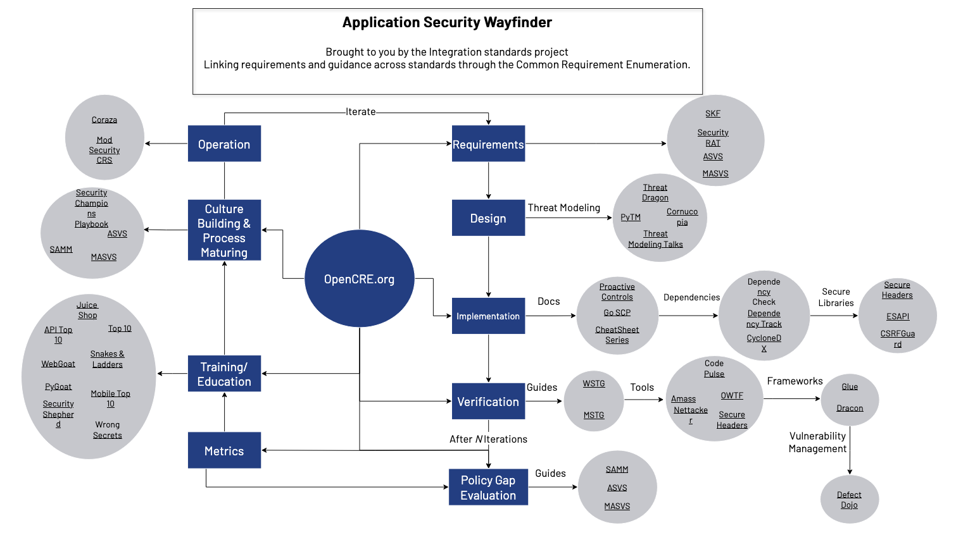
OWASP Projects
So much more…
370 Projects
Categorized as
Flagship Projects
Production Projects
Lab Projects
Incubator Projects
All free and open source 🤗
Read OWAP Developer Guide for more comprehensive overview.
https://owasp.org/projects/

Slide 30
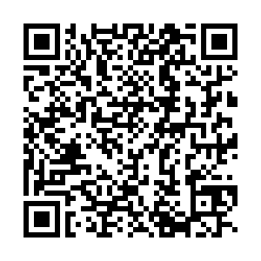
Thank You!
Are there any questions?
Download slides here 🤗

Slide 31
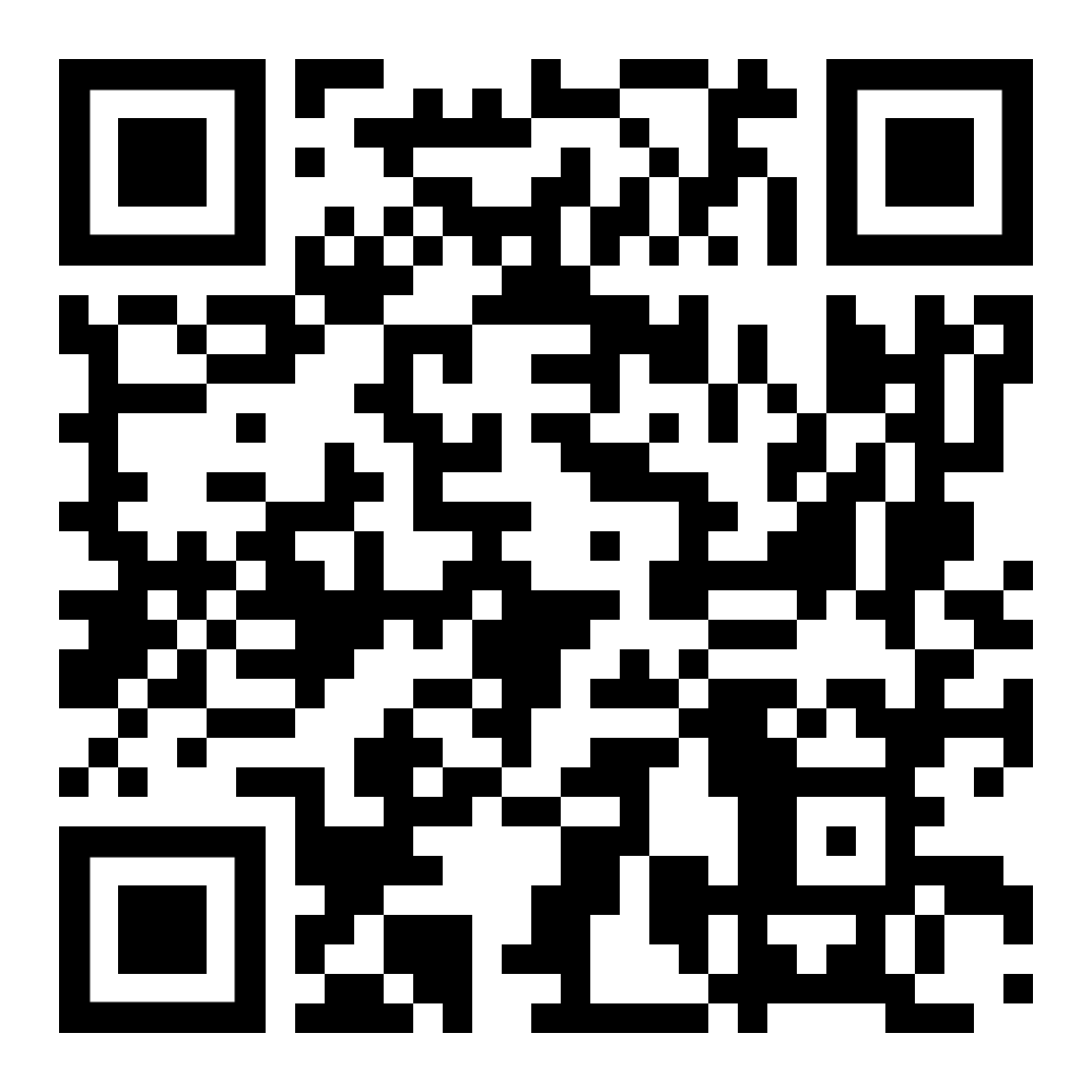
Sven Strittmatter
Lead Security Expert
sven.strittmatter@iteratec.com
Click an appointment w/ me →
No, its not a phishing website 😇

